Slide 1
5/8 Thermocline Updates

Slide 2
To-Do:
Check pressure drop and pump work calc / units + send to Luke
Add subplot for insulation cost, figure out what optimal insulation thickness is for each bed geometry
Test geometries with lower aspect ratio (e.g. 1:7, 1:10, etc)
Slide 6 figure with dT/dr vs time for each geometry
Exergy vs time for different bed geometries
Bar plot with $ vs radius , do for both types of insulation material (super wool, rock wool) for all geoms
Normalized plot with $/kWh rating
If time, insulation strategy
Parasitic pump
Given optimal insulation + cost + parasitic , get optimal bed geometry (middle of range we looked at) smallest h large d was optimal where does this go wrong
Analyze and come up with determination of what would be optimal given (exergy was just duration at which we could discharge constant temperature) balancing that with cost and parasitics
200 kwh thermal system
Next thing is diving into BOM and CAD drawing and engineering drawing sets
And as we get BOM get quotes
Peak airflow rate > blower
Plug back into TEA
Deeper view on TEA with assumptions

Slide 3
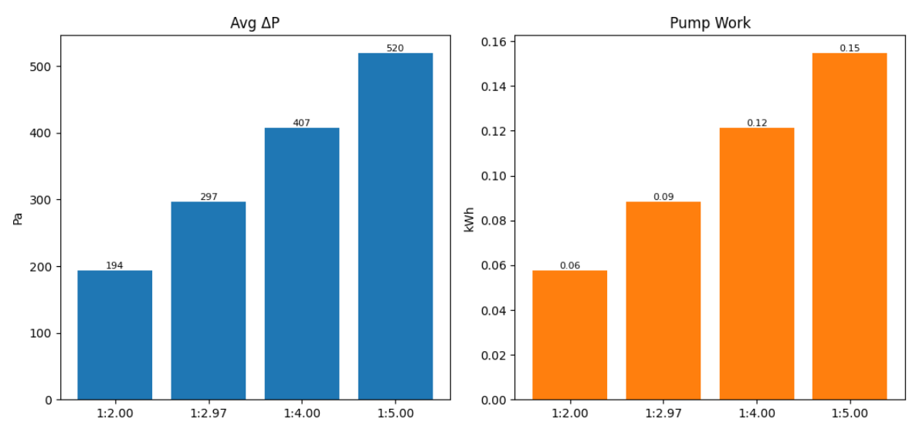
Average pressure drop and pumping energy vs geometry ratio
Notes:
Check pump work calc – just units? Or did I mess up calculation
Start writing up formulas in paper draft
Add subplot for insulation cost, figure out what optimal insulation thickness is for each bed geometry (figure out what insulation is req to maintain des temp)

Slide 4
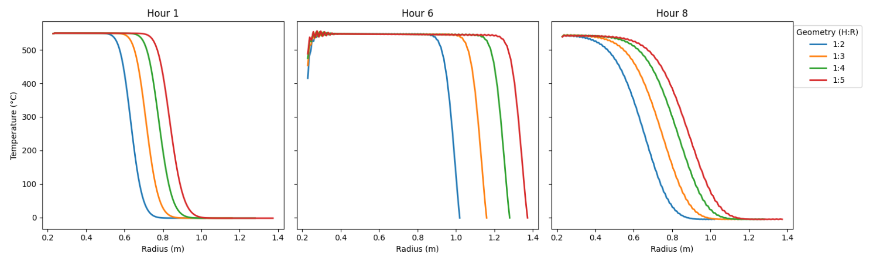
Thermocline Profiles at Hours 1, 6, and 8

Slide 5
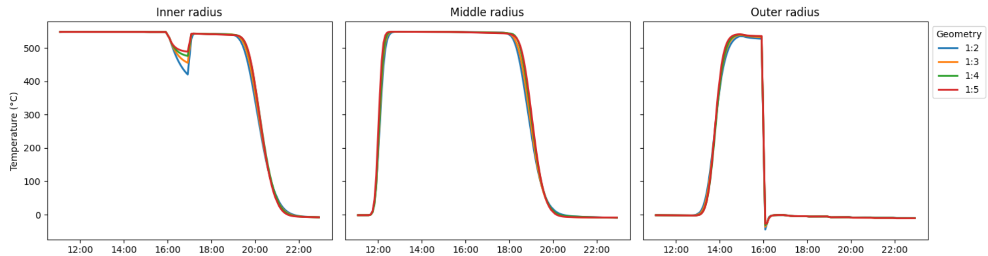
Temperature evolution

Slide 6
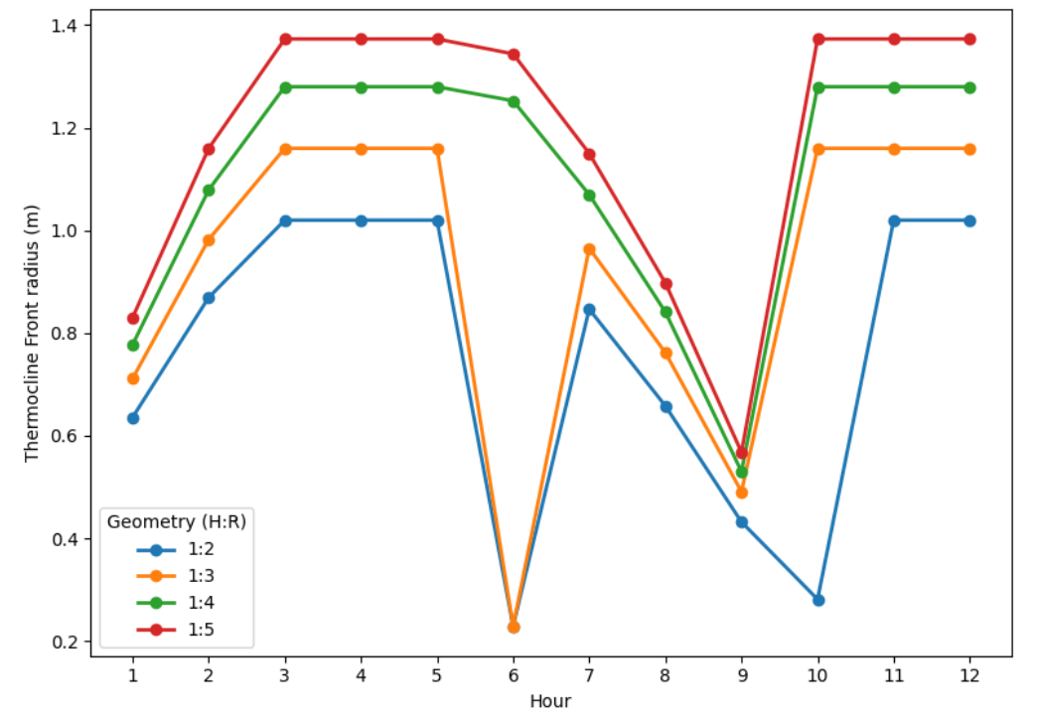
Thermocline Front Position (Radial position of steepest temperature gradient)
Notes:
Clean up hr 6
Make another figure w peak dT/dr (y) vs hour for each geometry (set threshold)

Slide 7
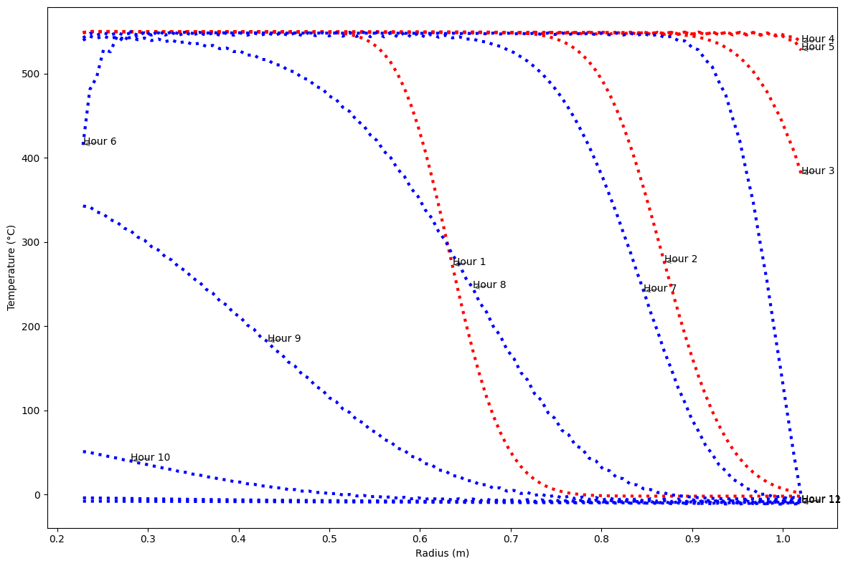
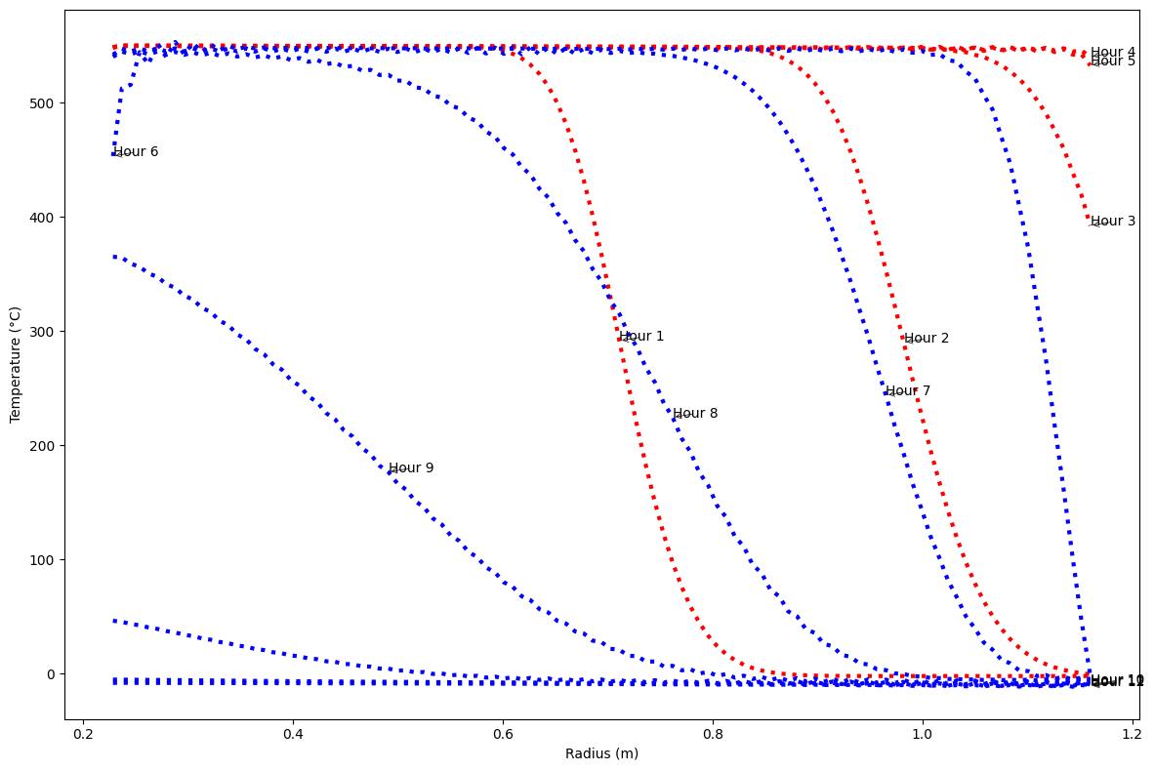
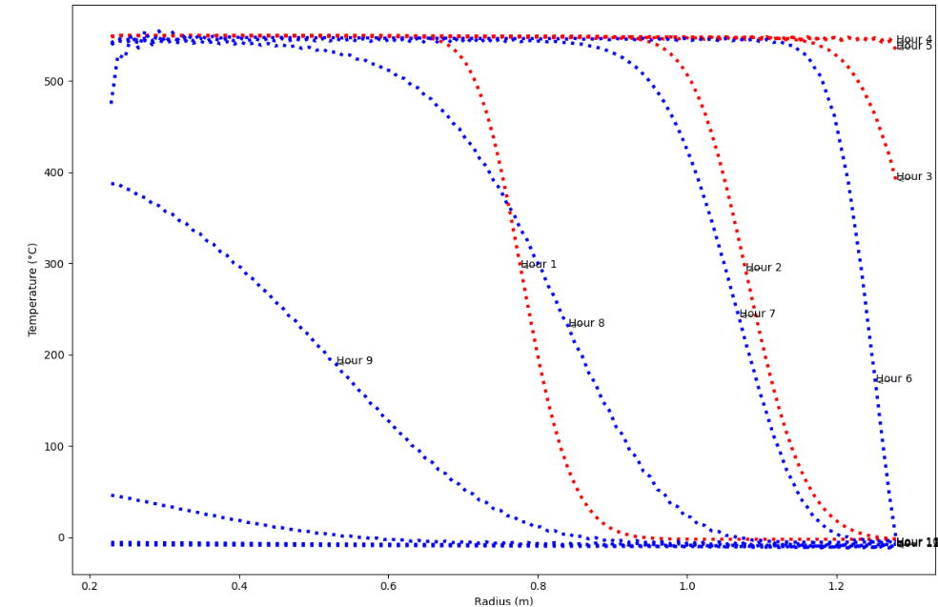
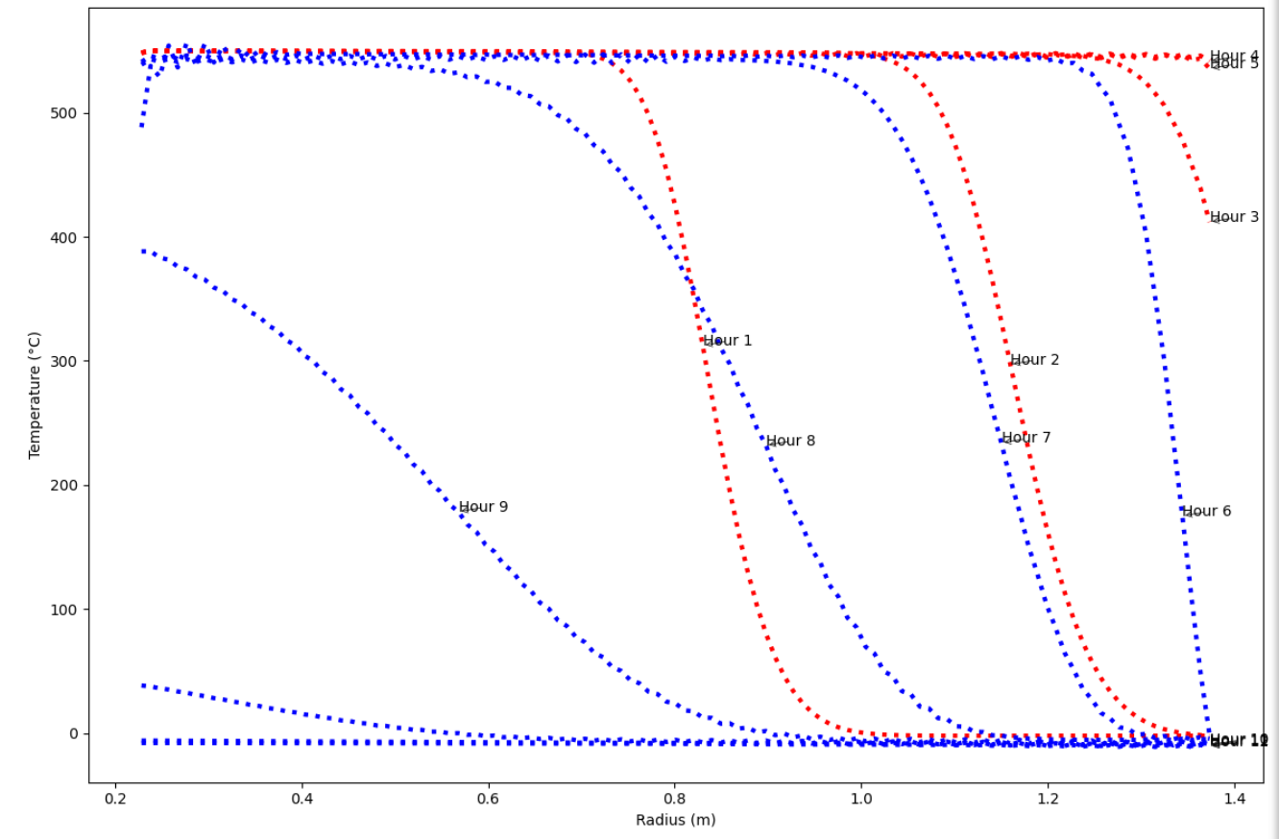
1:2
1:3
1:4
1:5

Slide 8
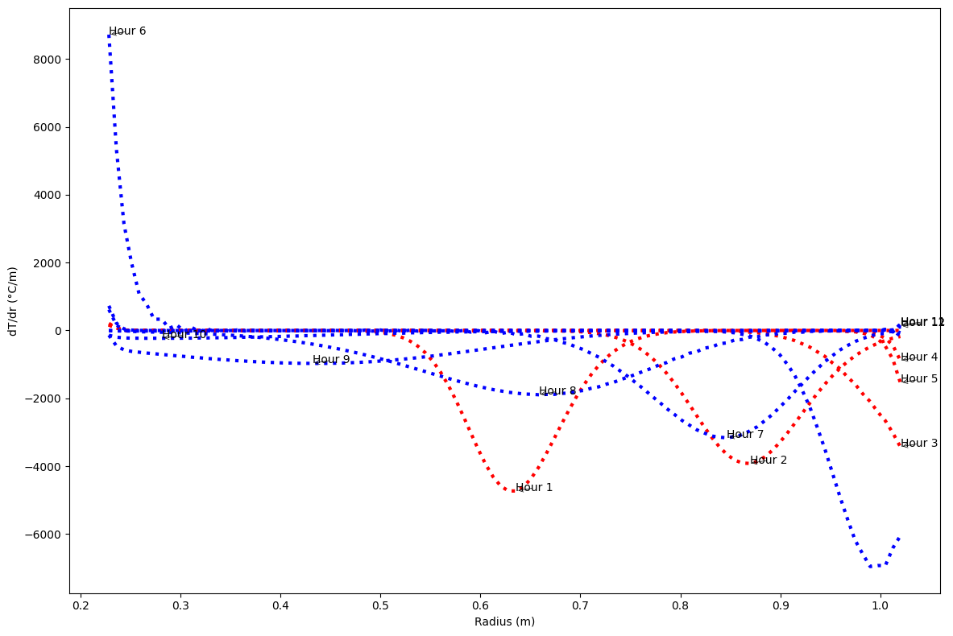
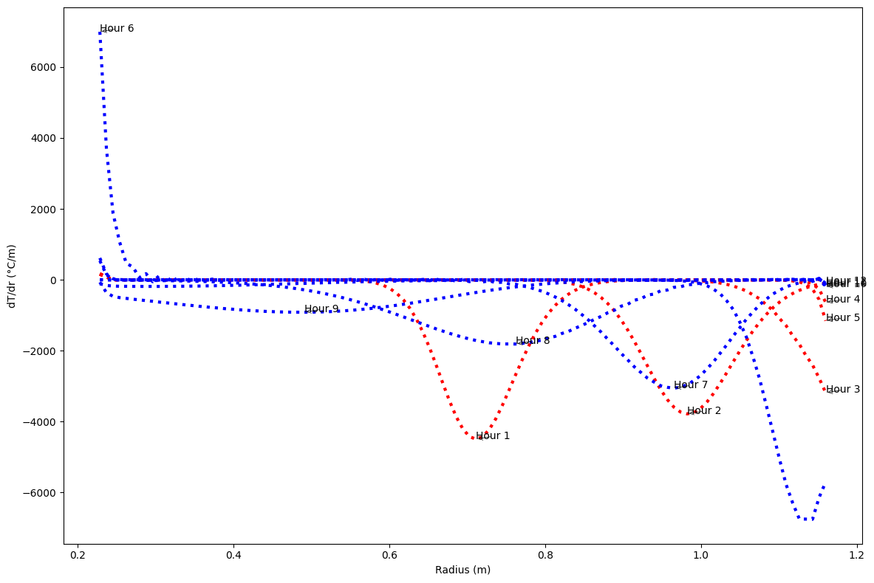
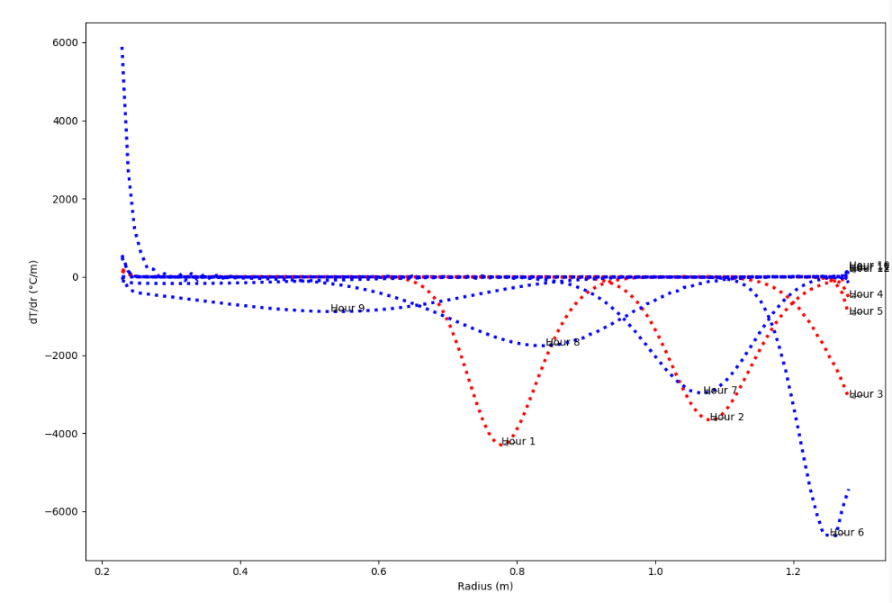
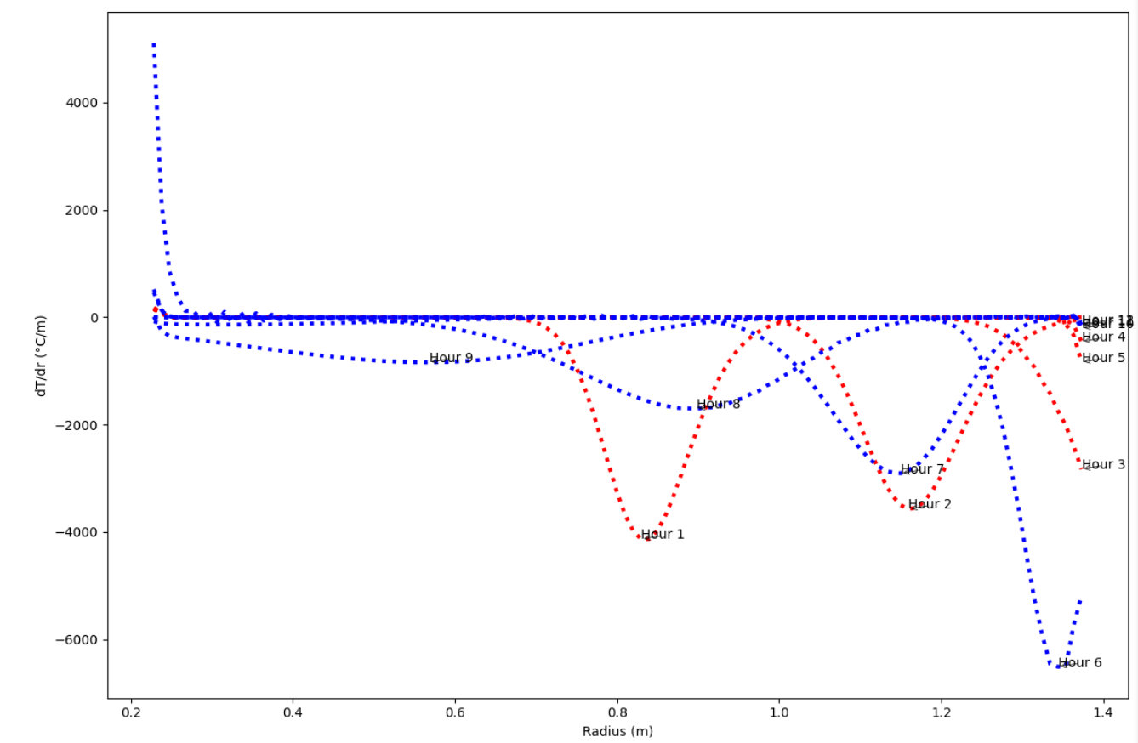
1:2
1:3
1:4
1:5

Slide 9
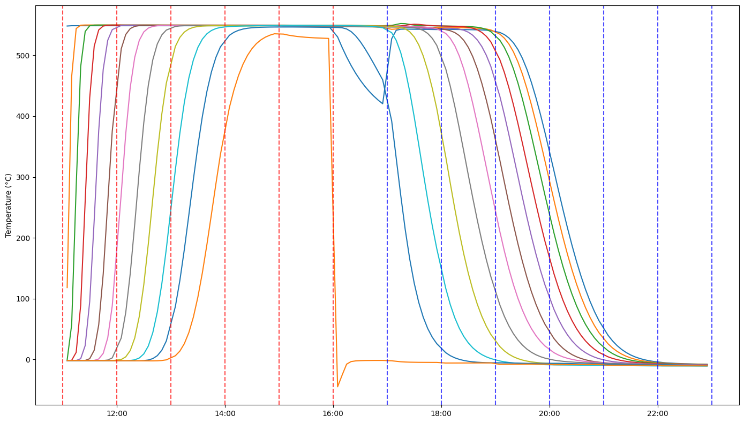
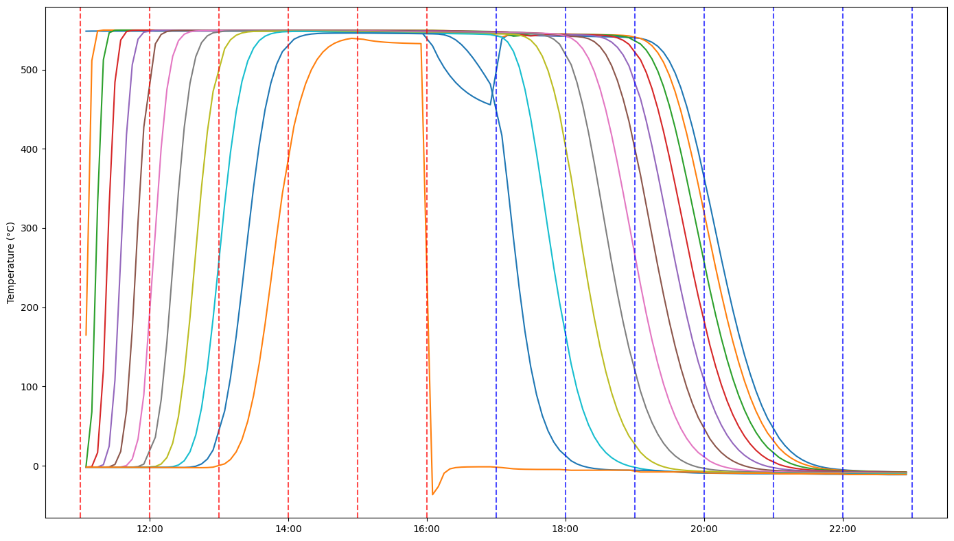
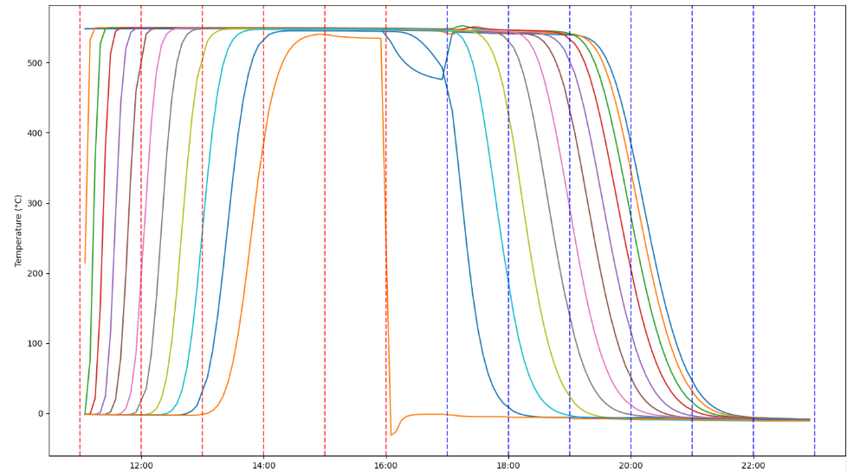
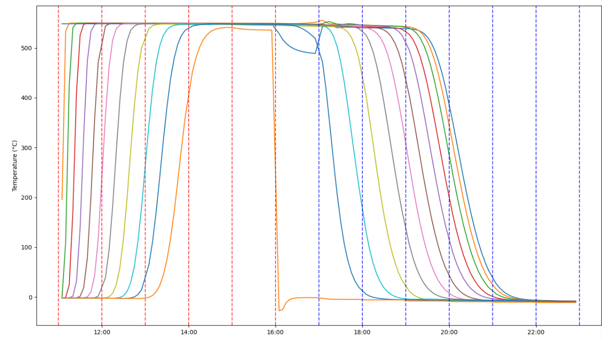
1:2
1:3
1:4
1:5
Notes:
Possibly extend beyond 1:5 – find true optimum
Bar plot with $ vs radius
Normalized plot with $/kWh rating
Insulation material – okay for base case, rock wool later when insulation thick calc done
Plot with insulation matls for each geom

